Slide 1


Public Image as a membership growth strategy

Slide 2
AGENDA
Membership 2025-2026
Goals and current state
5 Habit for growth
Tools available
Public Image
The Magic of Social Media
Stories
Tools/Resources available to fuel your PI and membership growth
Questions

Slide 3
Membership 2025-2026
July 1, 2025 - 1950
Goal Net + 100 (Current state + 42)
Average annual decline - 15% or 300 members (usually in Dec & June)
New Member goal - 400 new members or 20% growth in each club

Slide 4
5 HABITS TO GROWTH
TO GROW WE NEED TO
Want to change and grow
Know who you want to attract
Organize for growth
Include members in growth efforts
Keep growth top of mind

Slide 5
Tools Available

Slide 6
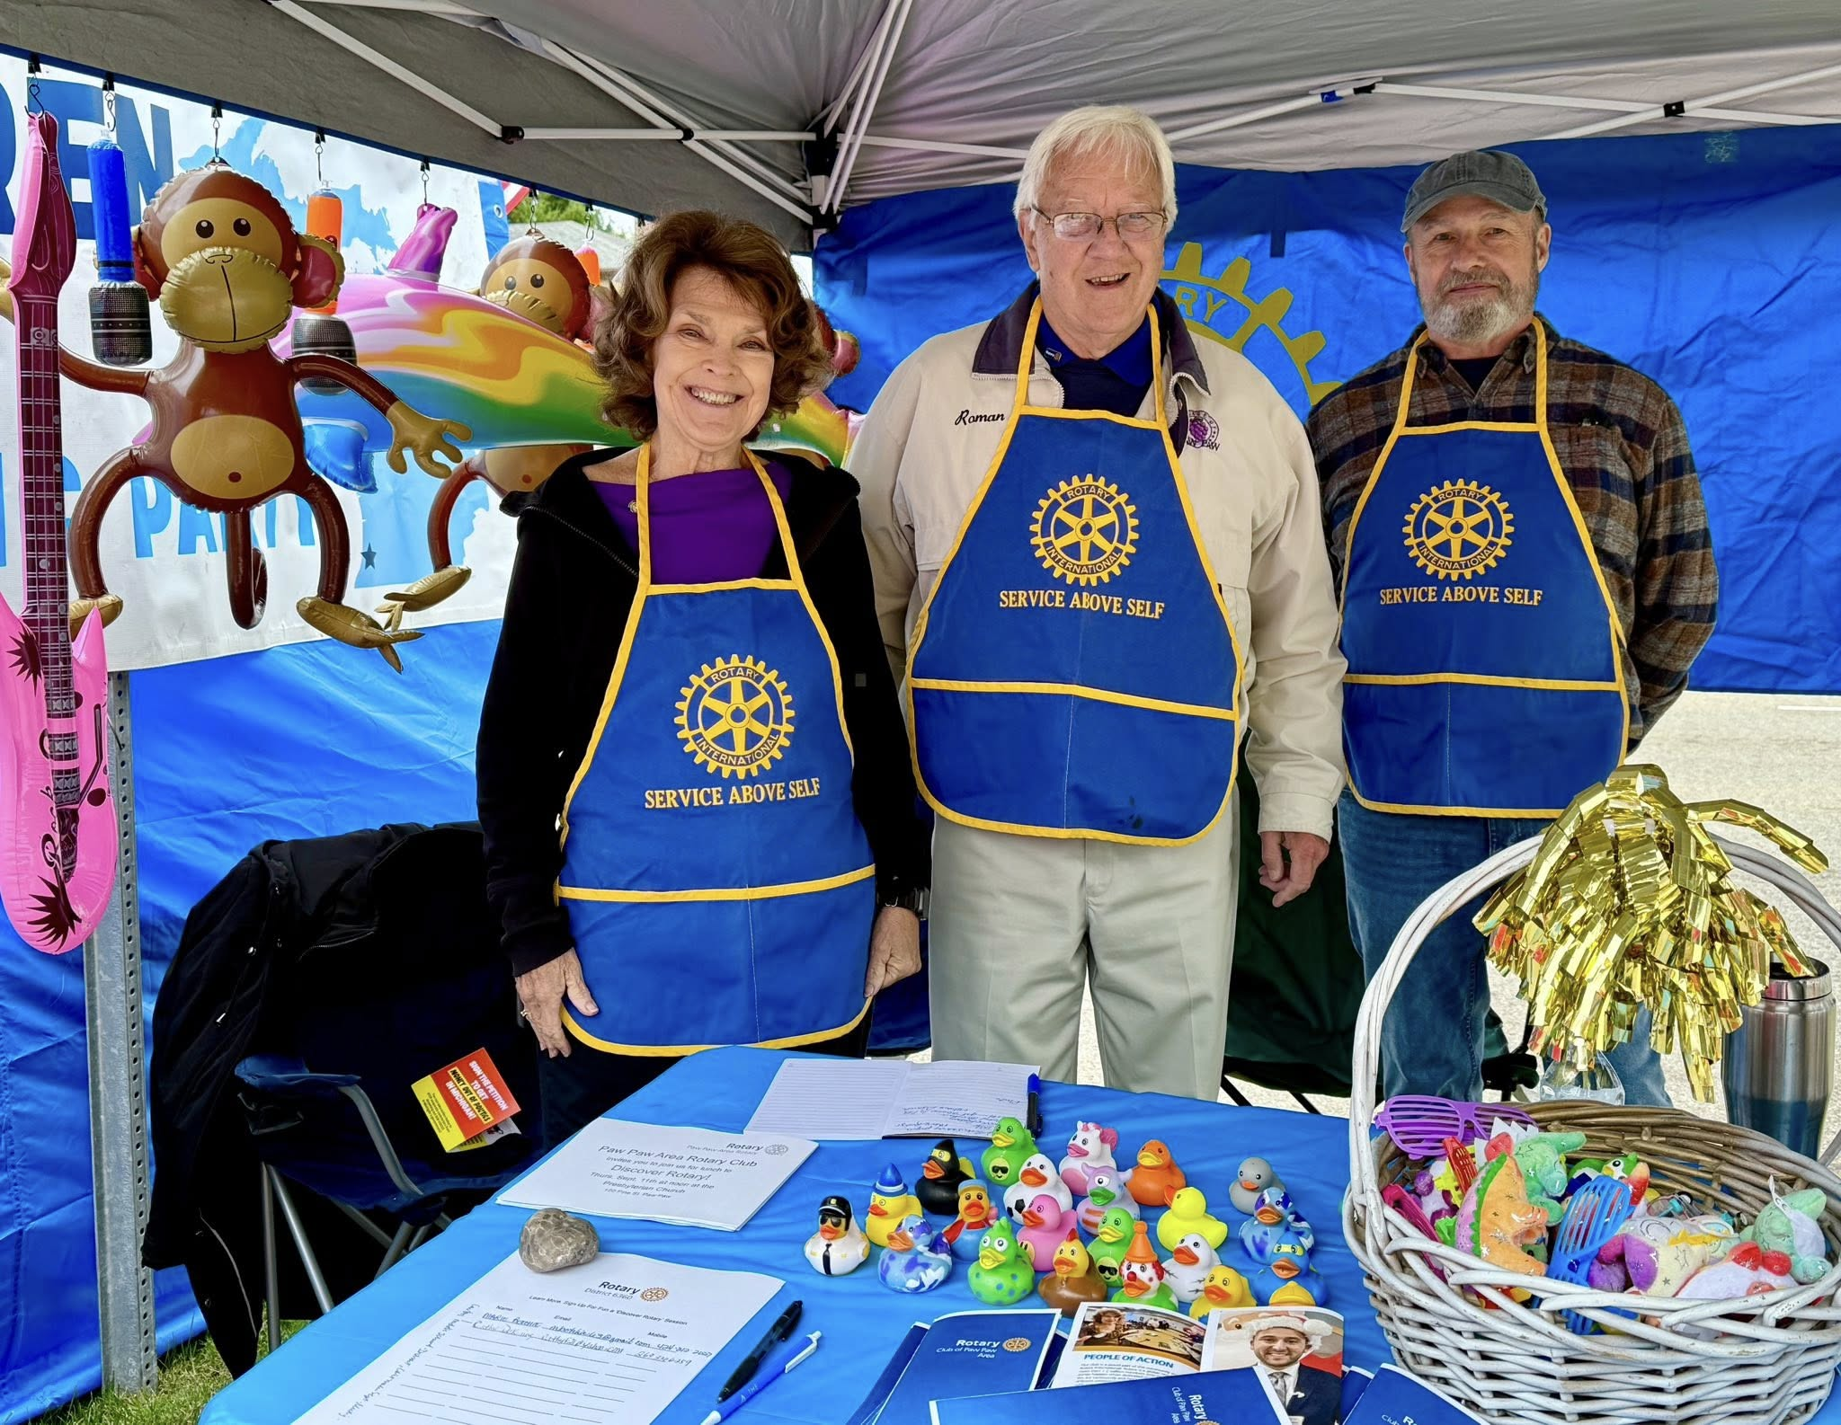
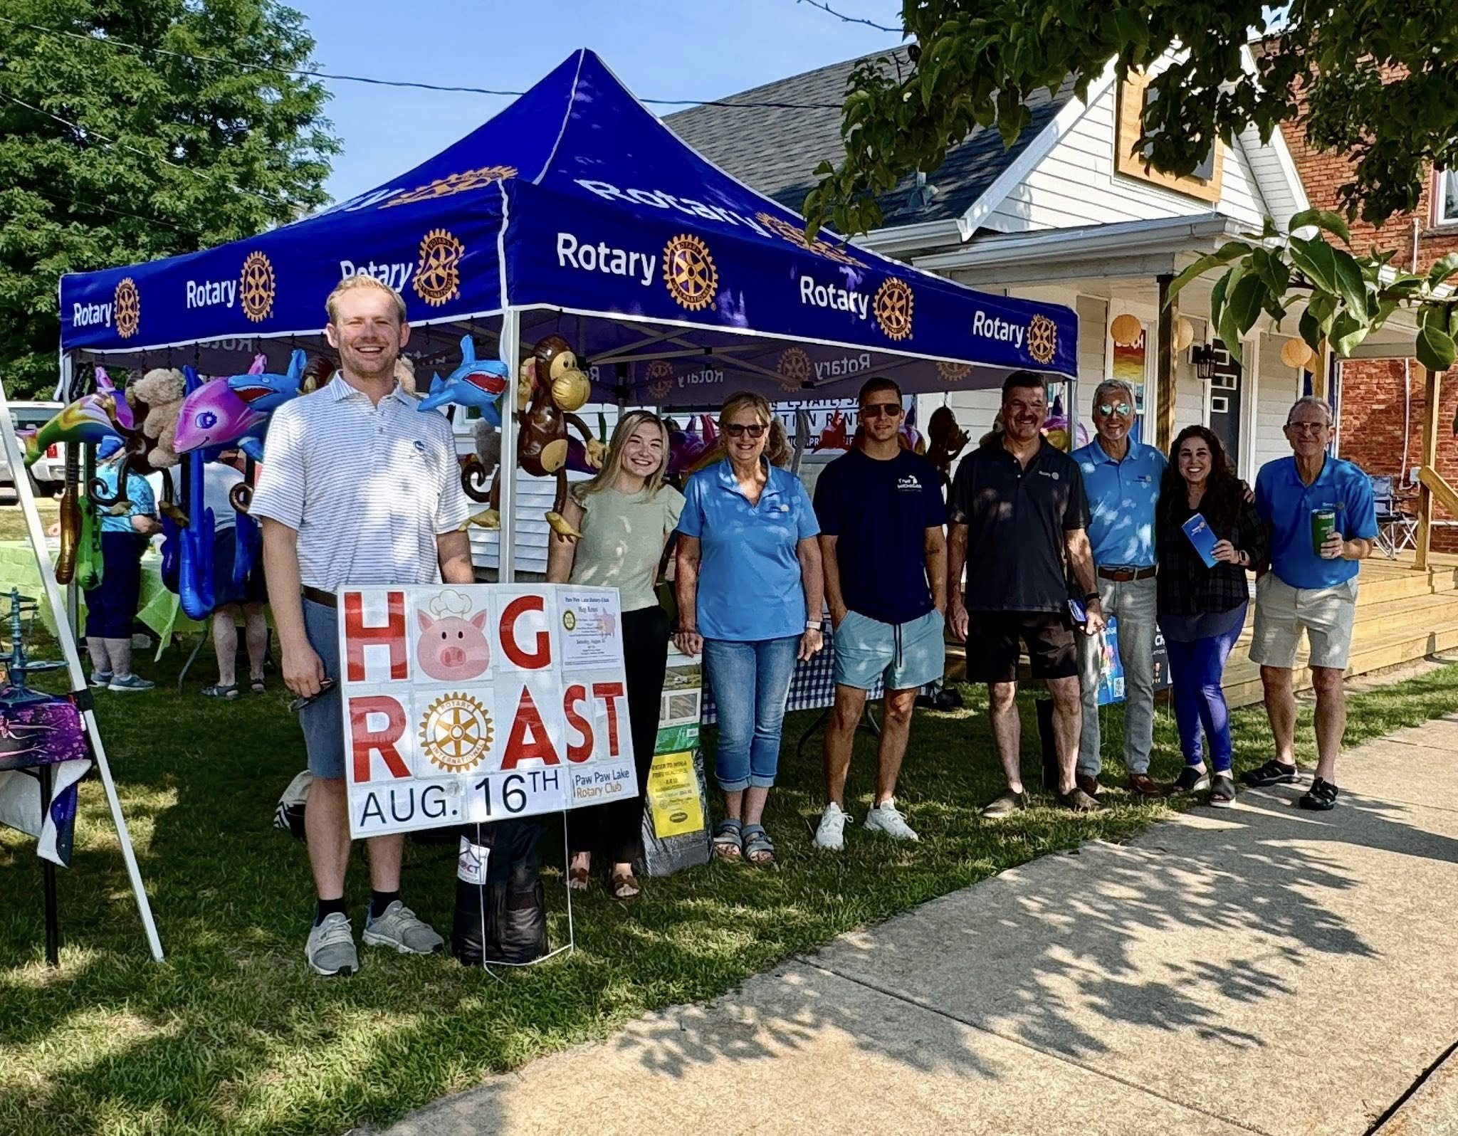
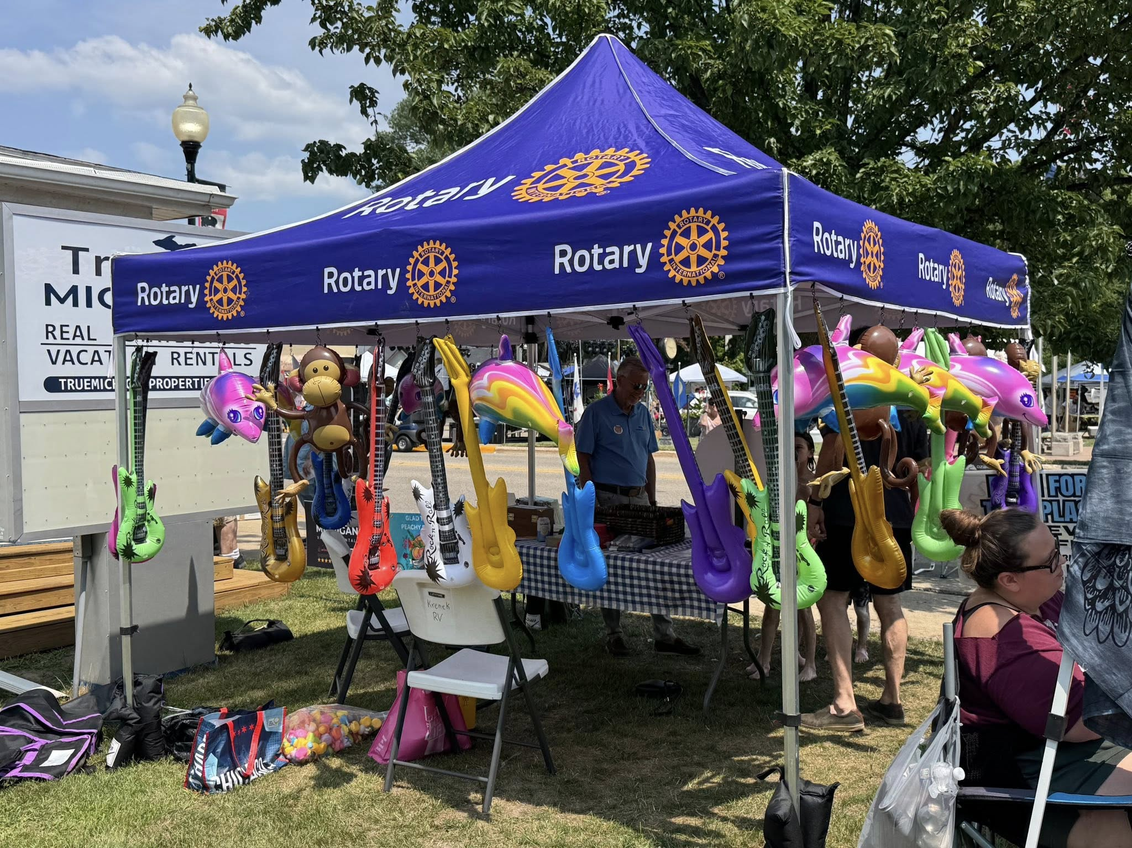
Set up tent, have games and sign up prospects to learn more at a Discover Rotary event the following week.

Slide 7
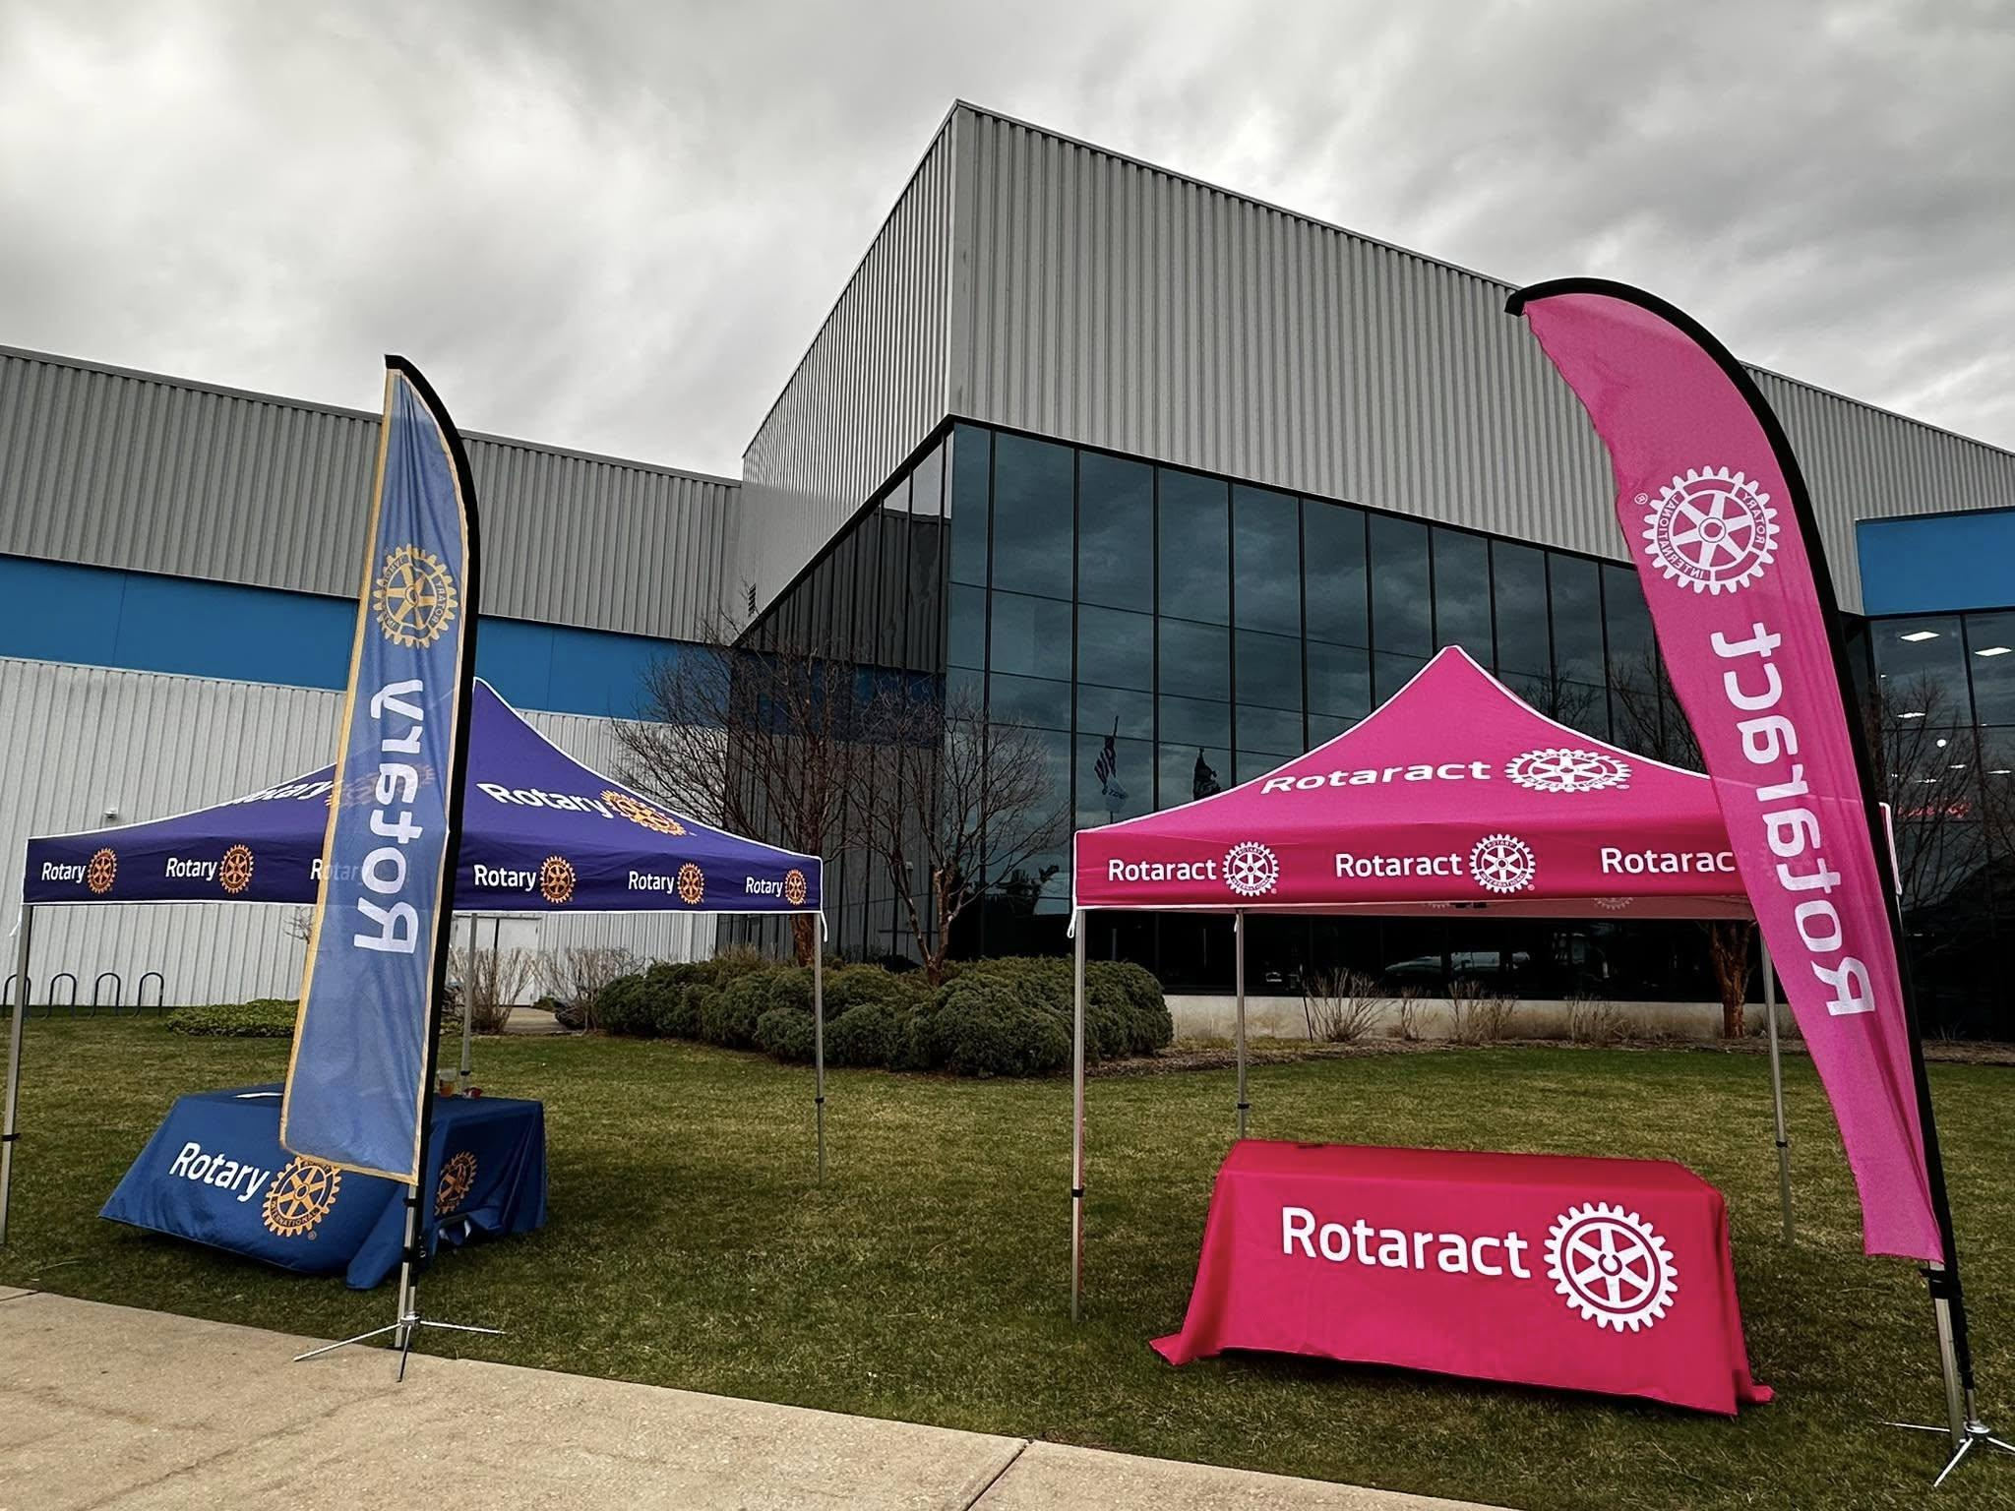
COMPANION CLUBS (special interests)

Slide 8
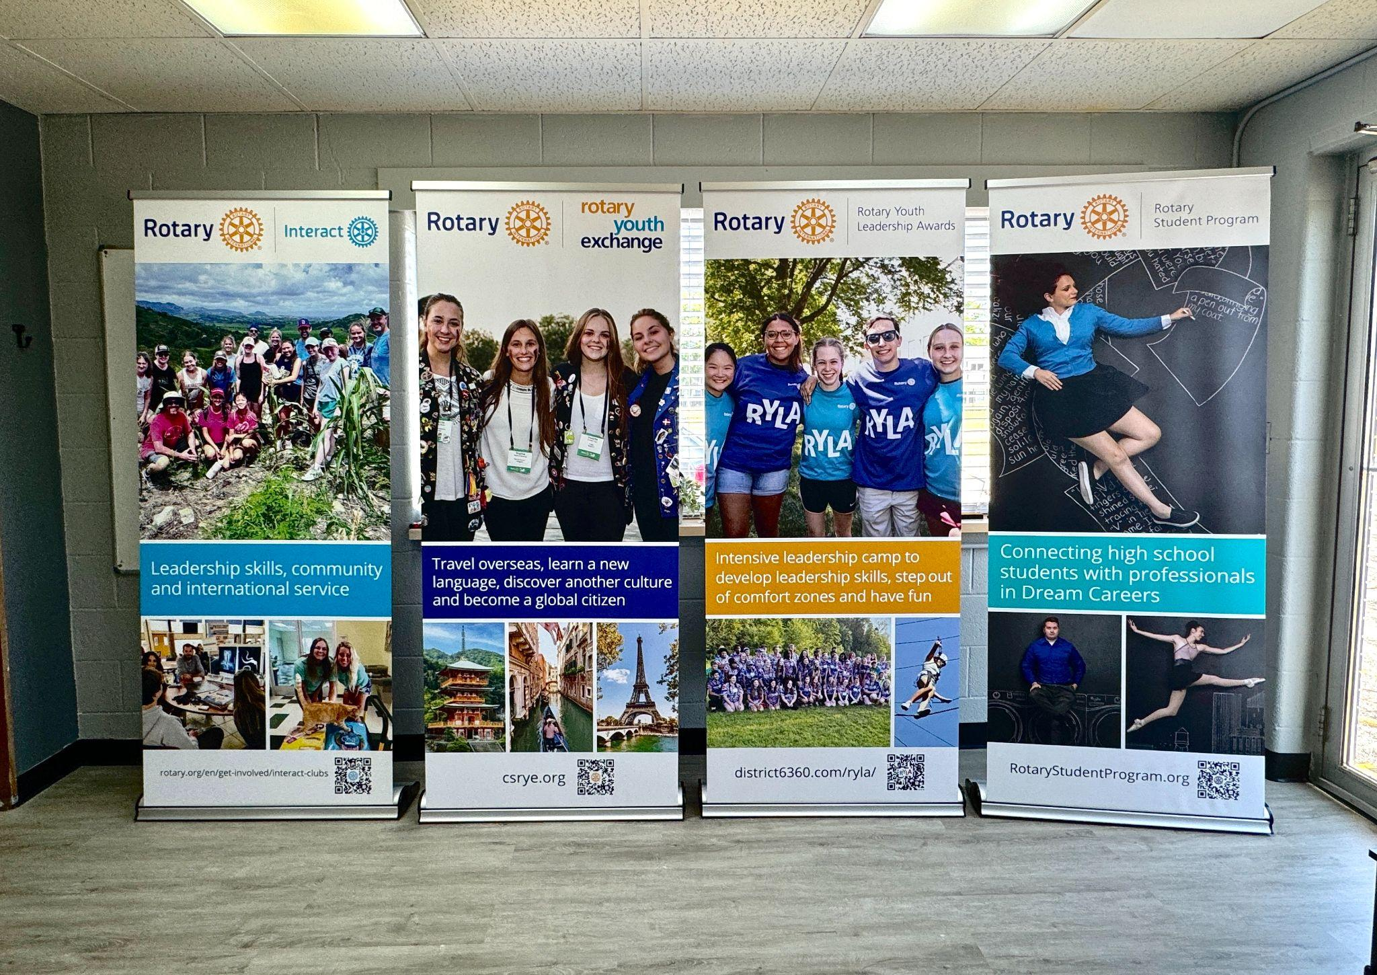

Slide 9
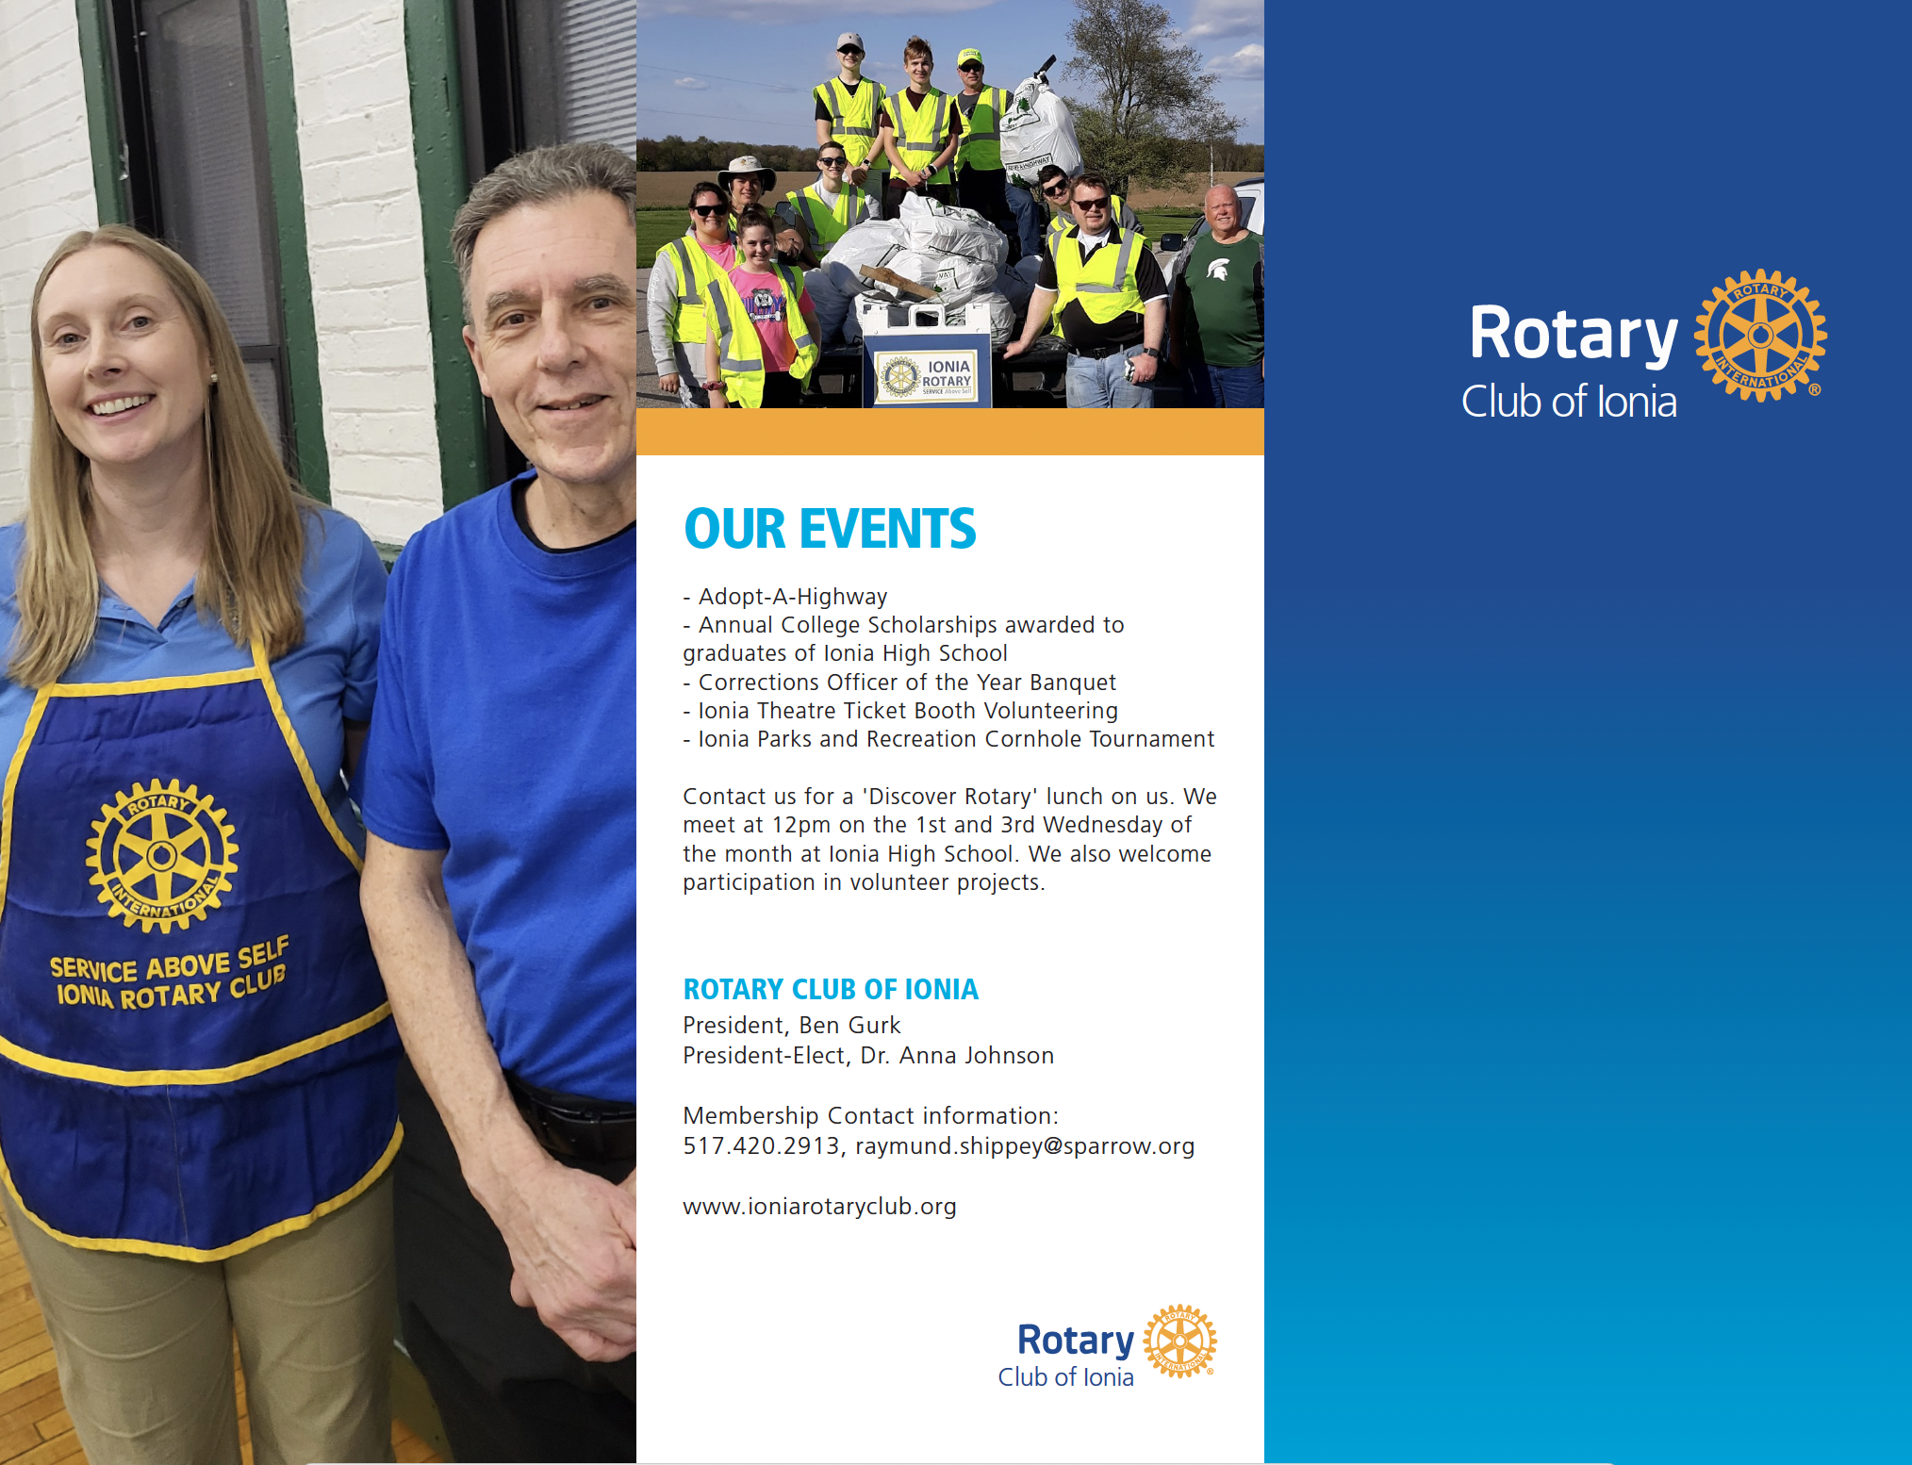
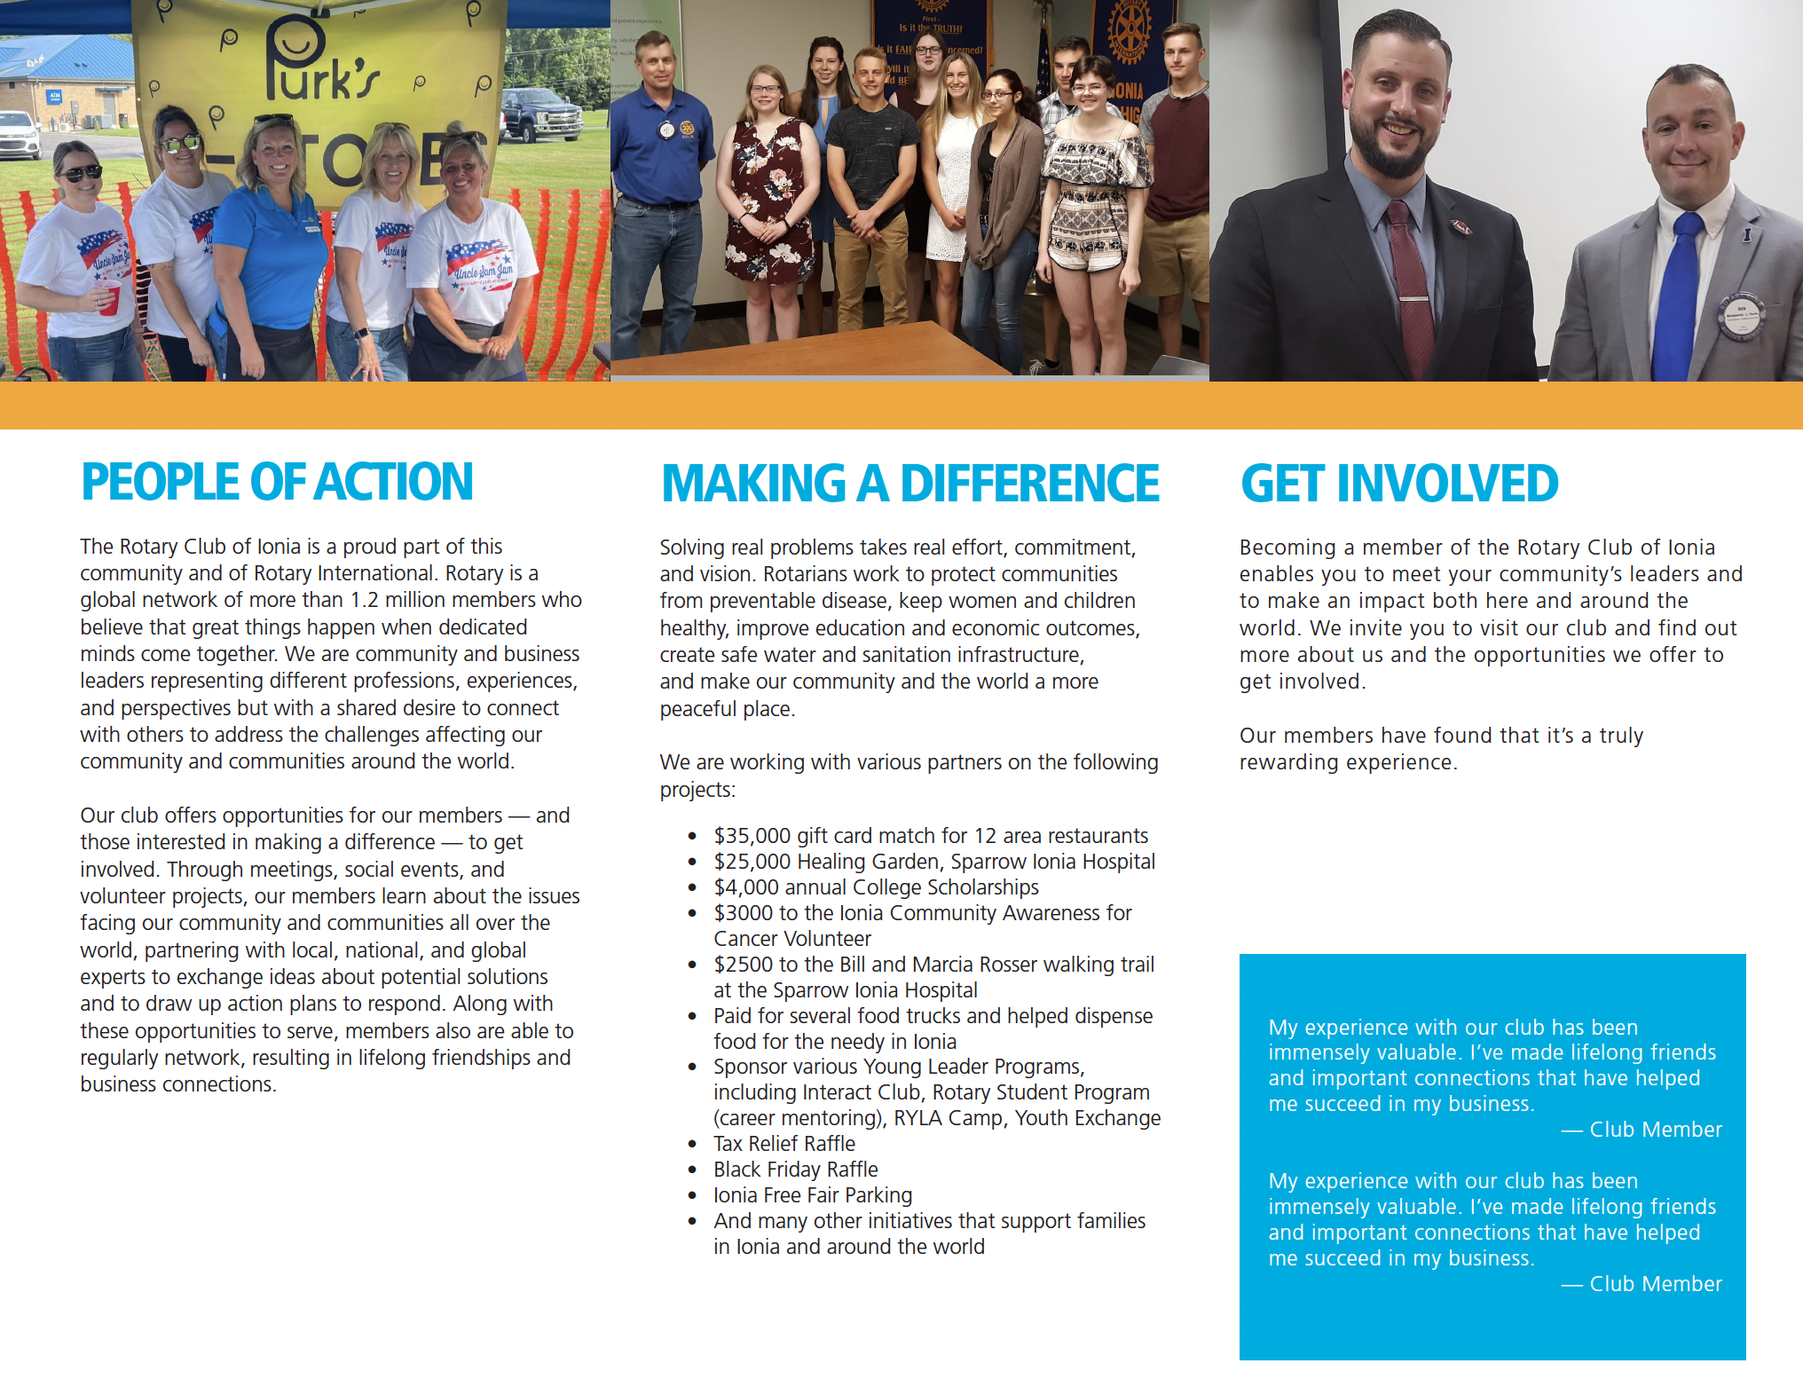

Slide 10
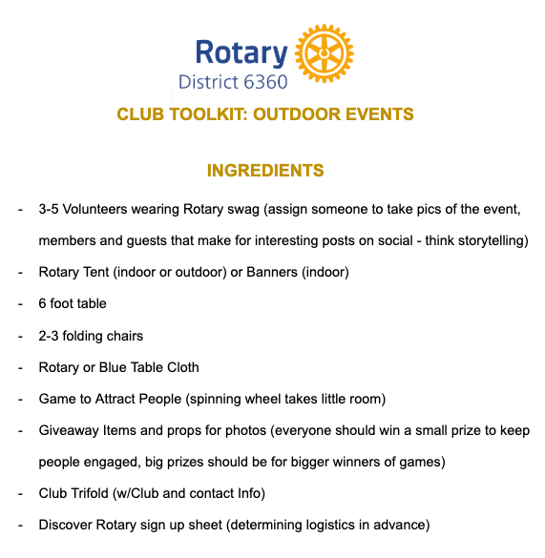
What is the recipe for a local event?

Slide 11
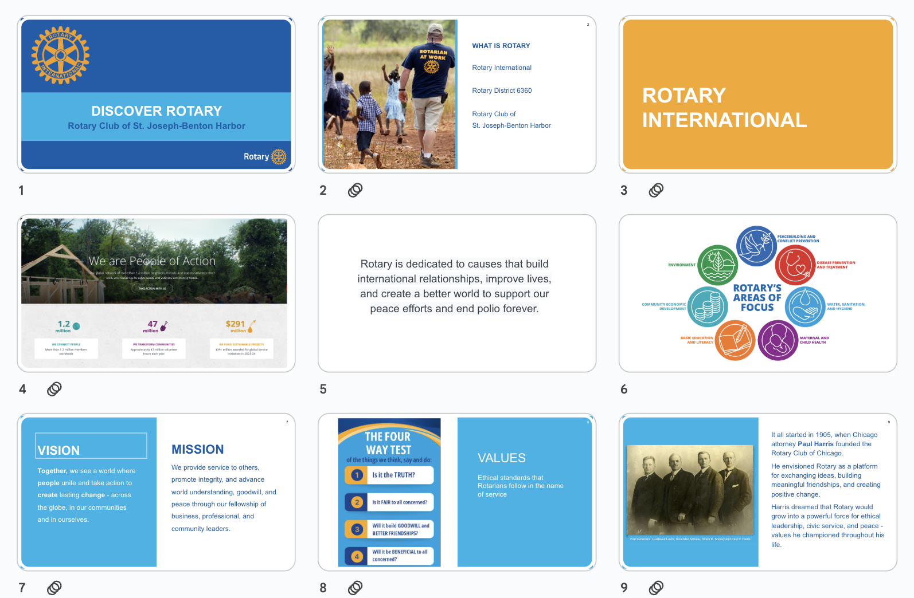

Slide 12
Public Image
as a membership growth strategy
“Social media”

Slide 13








USING GOALS FOR PLATFORM ROLES
THE PERCEPTION PLATFORM: Manage outside-view of company through employee culture and feedback
WORK
THE PURSUIT PLATFORM: Recruit most relevant talent based on those pursuing career opportunities
THE PROFESSIONAL PLATFORM: Illustrate thought leadership and industry expertise to maximize credibility
THE #PUNCTUATION PLATFORM: Communicate key headlines and incorporate business partners for max visibility
THE PLANNING PLATFORM: Inspire consumers as they are planning new projections or looking for ideas
THE PRESS-PLAY PLATFORM: Leverage video to tell brand story, provide value, showcase work
THE PICTURE PLATFORM: Engage consumers via visual storytelling across brand and product solutions
LIFE
THE PEOPLE PLATFORM: Personalize brand and enhance loyalty by leveraging promotions and consumer interaction
Notes:
Each platform works differently, and can reach a different type of audience. The bottom 3 are most commonly used for Rotary clubs, but different social media platforms, such as LinkedIn and TikTok can also be utilized.

Slide 14






ACHIEVING SOCIAL OBJECTIVES
CONTENT PILLARS
PLATFORM FOCUS
POST FREQUENCY
Design content pillars geared to
Prioritize social roles by how they
Decide how often you need to post on
social media objectives and are tied to business needs / are on-brand.
communicate for your goal and the potential prime prospect reach.
the social media channels based on goals and resources.
SOCIAL CALENDAR
SOCIAL TEAM
KPI MEASUREMENT
Plan each platform one month ahead
Identify core team with responsibilities
Determine KPIs / goals prior to
using simple solution such as Google Calendar or more advanced solutions.
geared to passion points or areas of interest for development growth.
strategy implementation, benchmark current status, and optimize once live.
Notes:
While making a social media account on every type might sound like a fun time, remember that you need to start with establishing objectives and what type of content you want to provide.
Content Pillars: Your content should focus on being relevant to your goals, and are free of branding mistakes.
Platform Focus: Establish goals for each platform and be aware of the audience for each
Post Frequency: You and your PI team should establish how often you want to post based on your goals. Keep in mind that posting too often can lead to “doom-scrolling”. Use analytics data to see what works best for your team.
Social Calendar: Plan ahead! Media calendars are your friend. Meta has a built in one that I will show later
Social Team: Assign roles to your team depending on what skill sets and passions they have. Avoid too many hands on the button
KPI Measurements: Watch those analytics and learn from them

Slide 15
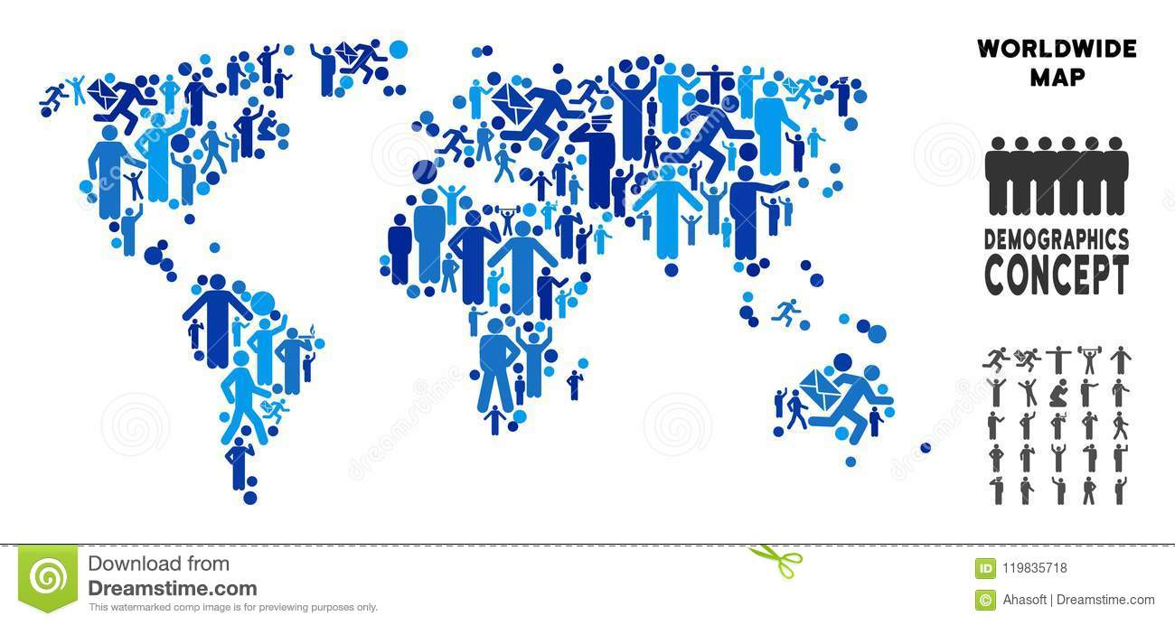

Globally, Facebook has over ~3.1 billion monthly active users as of 2025
In the US, Millennials are, on average, the most popular age group of Facebook users:
67% of people aged 18-29
75% of people aged 30-49
69% of people aged 50-64
58% of people aged 65+
Gender: In the U.S.,
53.8 % female
46.2 % male
7.8 B
3.1 B
Post regularly (e.g., 2-3 times/week) but prioritise quality: good visuals, short caption + call to action (“join us”, “learn more”).
Notes:
Facebook is widely used, and is likely the most commonly used platforms for the clubs. Millennials are the easiest to grab from this platform, but there is a good amount across each age bracket. You don’t have to post every day, but try to get in at least 2-3 posts a week for a solid reach.

Slide 16

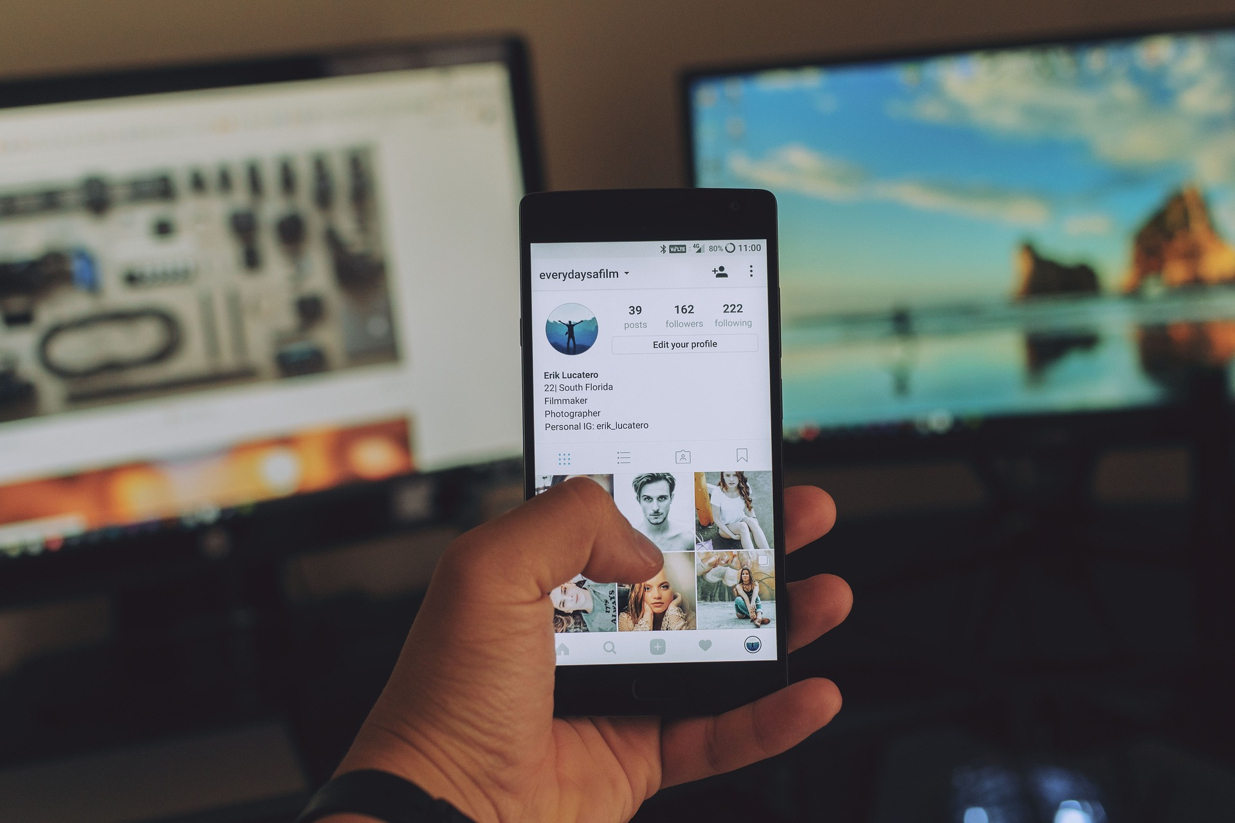
Instagram’s corporate mission is
“to capture and share the world's moments.”
Notes:
Another part of Meta is Instagram, or Insta for short.

Slide 17
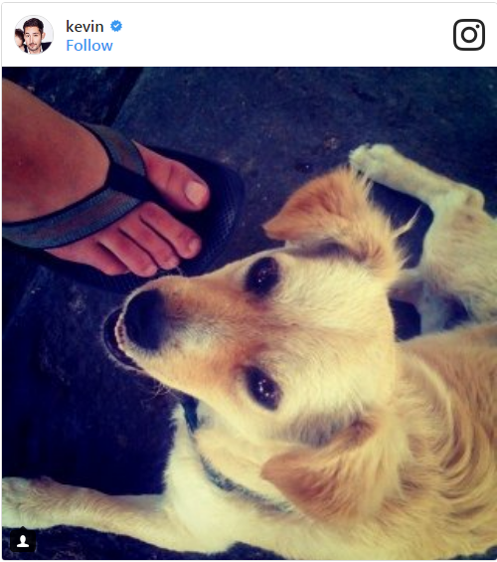
Instagram’s core user base is younger:
globally ~62 % of users are aged 18-34.
In the U.S.: ~76 % of people aged 18-29 use Instagram; ~66 % of aged 30-49.
Gender split is nearly even globally (50.6 % male / 49.4 % female) according to one source.
Visual-heavy: high quality photos, behind-the-scenes, “story” format.
Use Instagram Stories to show live-in-action: e.g., members during a service project, prepping event, volunteer snapshots.
If your club wants to attract younger professionals (e.g., age 21-35) — Instagram is critical, because that demographic is heavy on Instagram.
Notes:
Instagram lives on visuals as a story over words. This is why younger professionals prefer it. Easier to scroll, but harder to get a lot of reading. Keep it short like a snapshot. Also keep in mind photos are squares, unlike FB, which can vary. Think of it as a Polaroid image of your story

Slide 18
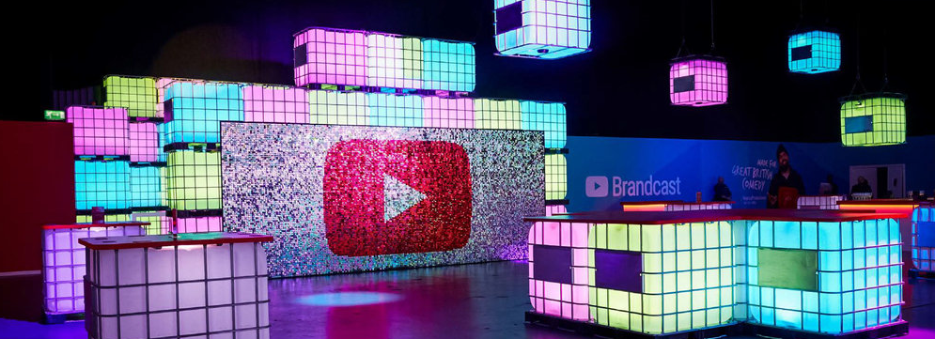
YouTube’s corporate mission is
“to give to give everyone a voice and show them the world.”

Slide 19
Online Video reaches more 18 to 49 year old consumers in the U.S. than the sum of all cable TV networks put together.
1B
Globally very large scale: as of Feb 2025, ~2.74 billion monthly active users.
Age: largest age group is 25-34, then 35-44, then 18-24.
Gender: roughly 54 % male vs ~46 % female globally.
hours of video watched everyday.
Longer-form video content: e.g., 3-10 minute videos presenting club history, project recaps, interviews with members, partner organisations, community leaders.
“How-to” / educatives: e.g., how the club executes a service project, how to join, how membership works, benefits of Rotary.
Notes:
Youtube is a very large scale usage, but not widely used by those over 50. While you can use videos on Meta platforms, Youtube is where you will grab those who want longer videos.

Slide 20
Channel and content
“Platform + Purpose” Alignment
Facebook → Best for community building, announcements, membership retention, older or existing members, local outreach.
Instagram → Best for younger professional recruitment, visual storytelling, brand awareness, dynamic content.
YouTube → Best for deep engagement, telling the story, positioning the club as thought-leader, recruiting, sharing long‐form impact.
Content Pillars – For all platforms you should define 3-5 key pillars. For a Rotary club that might be:
Service & Impact – Show what the club is doing in the community (volunteer work, projects, partnerships).
Member Stories & Culture – Highlight members, their motivations, benefits of being a member, club culture.
Events & Learning – Speakers, workshops, club meetings, youth programs, training.
Call to Action / Recruitment – Content encouraging people to join the club, attend as guest, partner with the club.
Rotary Brand & Global Link – Tie local club to global brand (e.g., Rotary’s themes, global service, fewer polio cases), showing connection to something bigger.

Slide 21
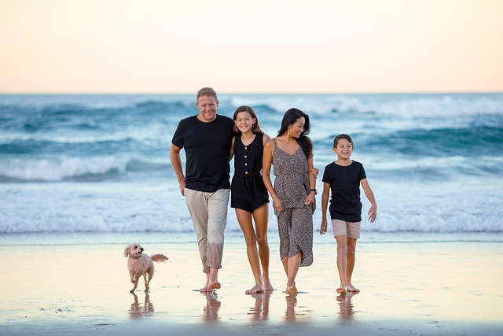
A Path to membership
Kelly moved to town with her husband and 2 teenagers and is interested in networking and getting involved in the community
Kelly saw social posts on fun events that Rotary was doing in town
A new friend liked a post of a service project being done by the high school Interact club
Kelly asked her friend about Rotary and was invited to a session to learn more about Rotary and Interact (Discover Rotary)

Slide 22

A Path to membership
Wendy and Carl just retired and want to get more involved in the community and giving back.
Carl saw Rotary members over the years with Rotary shirts doing various community events and suggested to Wendy if they knew anyone in the club.
Then Wendy saw an article online about how the local Rotary club was refurbishing the local food bank before the holidays
They search for the Rotary club in town and found the website and sent in a request to learn more and discovered they knew a few of the members

Slide 23
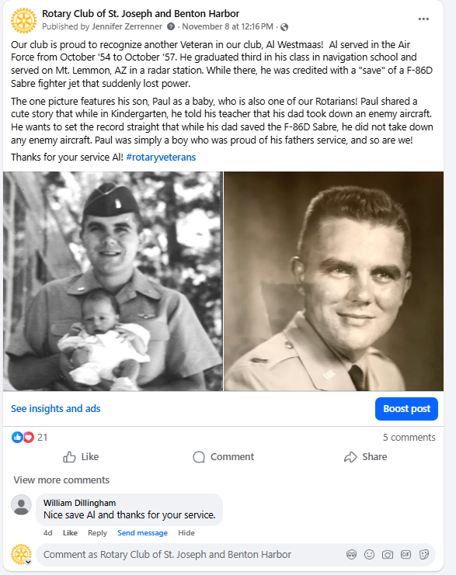
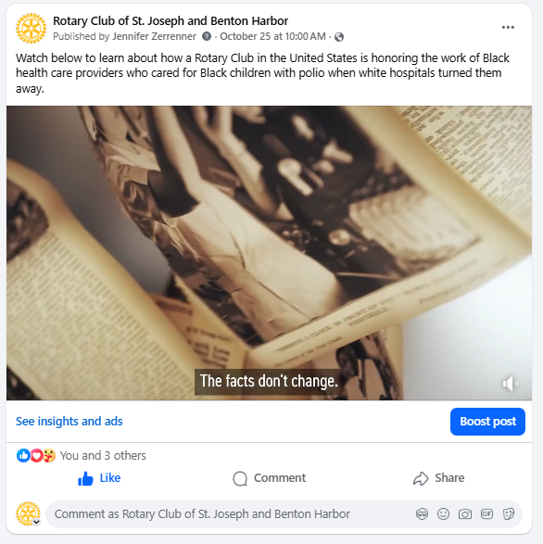
Social Post Examples - Rotary Focused
Notes:
Here are examples of Social media posts that are Rotary Focused. This could be on a Rotarian, rotary events, or content from the brand center. Brand center is your friend! Be careful of copyright infringement or trademark usage. Give credit to creatives. Don’t remove watermarks.

Slide 24
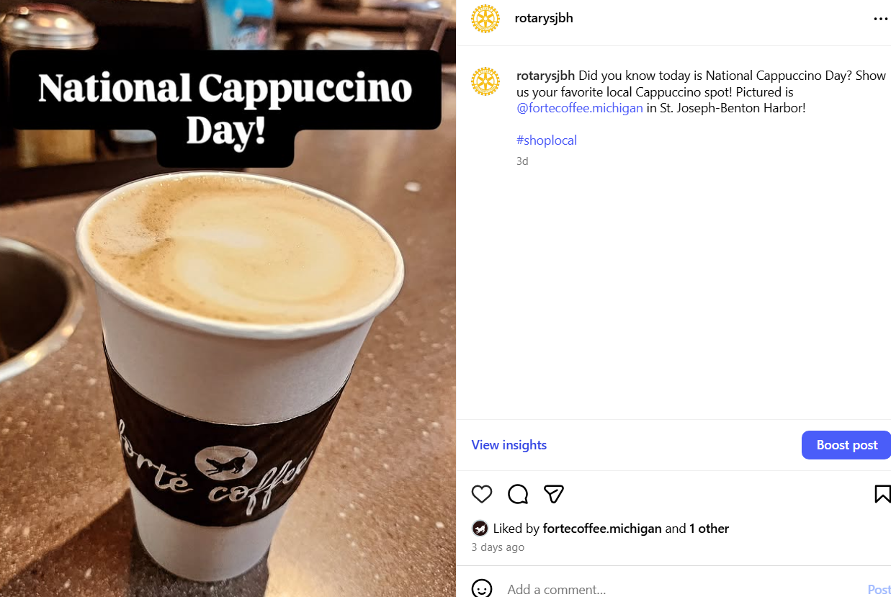
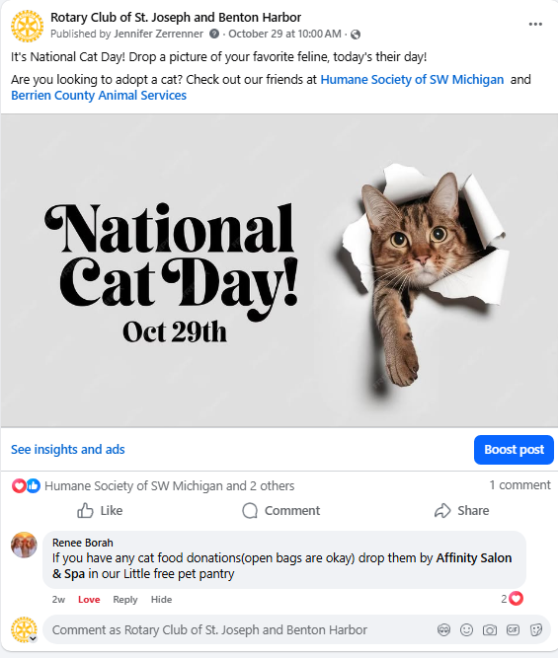
Social Post Examples - Community Building
Notes:
These are examples of community building posts. Take advantage of fun days and national days where you can spotlight area businesses

Slide 25
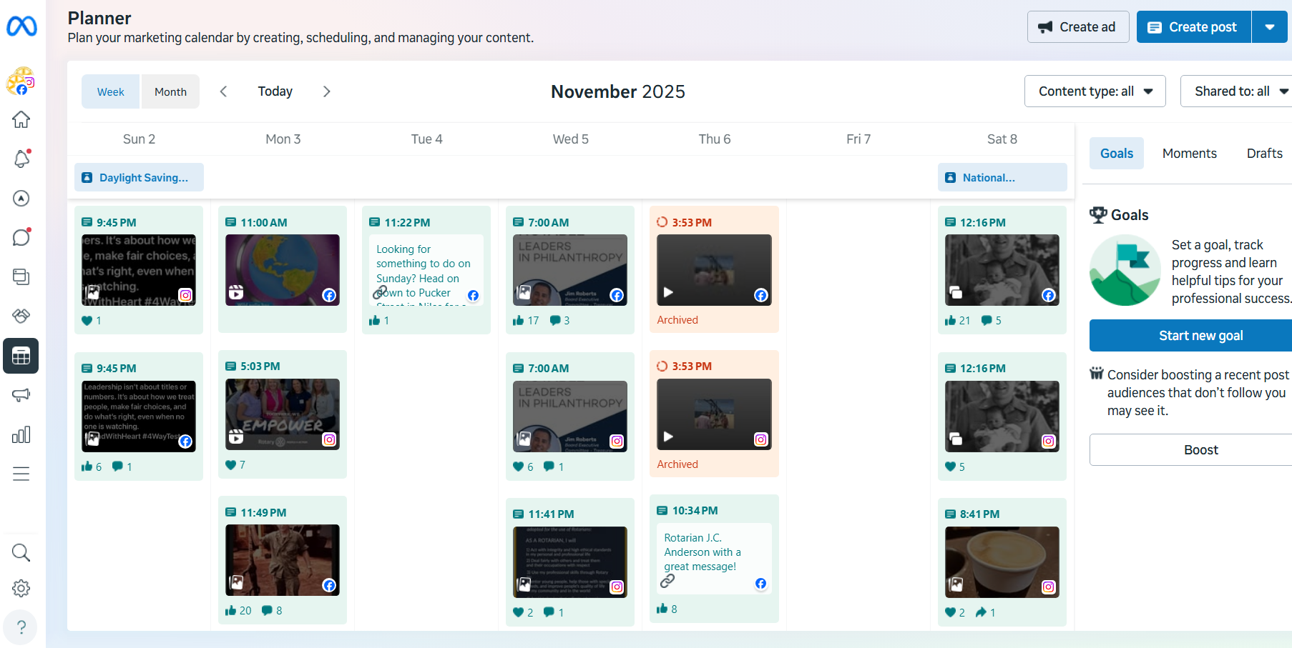
Meta Planner
Notes:
This is the Meta planner where you can plan out content a month ahead of time. Explain it a bit

Slide 26
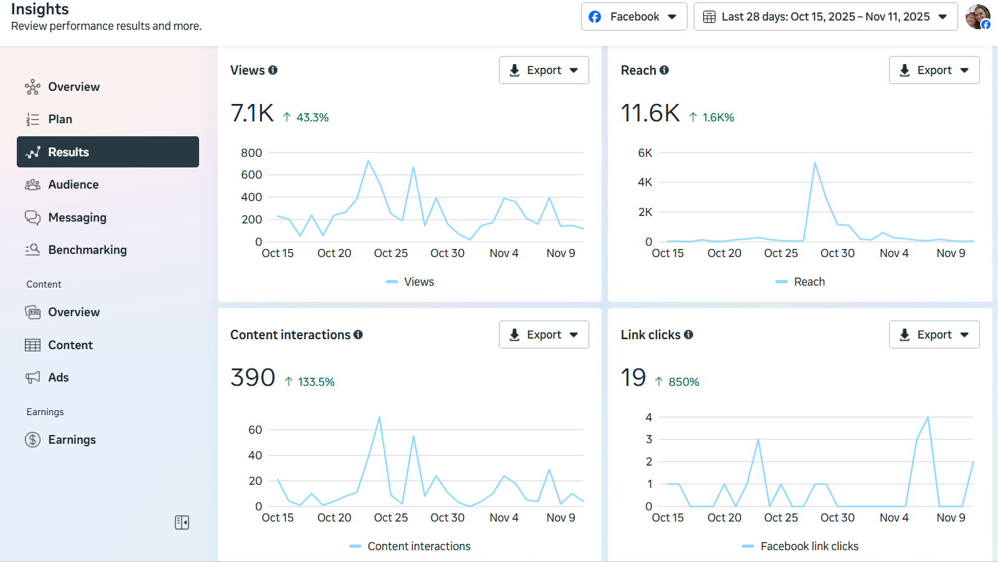
Analytics and Insights

Slide 27
Top 10 List of where to get started
Establish Club Presence
Create and maintain official Facebook, Instagram, and YouTube accounts for your club.
Use consistent branding—logo, club name, meeting info, and contact details.
Define Content Pillars
Identify 3–5 recurring themes that represent your club’s story:
Service Projects, Member Spotlights, Youth Programs, Community Partnerships, Global Impact, Fun & Fellowship.
Train Club Members
Host short training sessions showing members how to follow, like, comment, and share posts.
Their engagement is the easiest way to multiply your reach.
Build a Media Team
Recruit a few members (or Interactors/Rotaractors) to capture photos and short videos at meetings, events, and projects.
Use a shared folder for easy uploads.
Increase Local Visibility
Wear Rotary-branded shirts, display banners/tents, and attend community festivals and volunteer days to boost visibility and recognition.

Slide 28
Top 10 List of where to get started
Share News Through the Community
Create and send press releases to local newspapers, radio, and online outlets for major events, service projects, awards, and donations.
Engage Guest Speakers
Tag and thank speakers on your club’s social channels.
Encourage them to follow your club and share your post with their own followers.
Expand Your Network
From your club accounts, follow local nonprofits, schools, chambers, and community leaders.
Comment genuinely on their posts to build relationships and attract new followers.
Plan and Schedule Posts
Use free tools like Meta Business Suite or Canva’s Content Planner to schedule posts weekly.
Consistency is key—aim for 2–3 posts per week across platforms.
Track and Celebrate Growth
Monitor engagement (likes, shares, new followers) monthly.
Share results during club meetings to celebrate progress and motivate members.

Slide 29
Questions?

